Slide 1
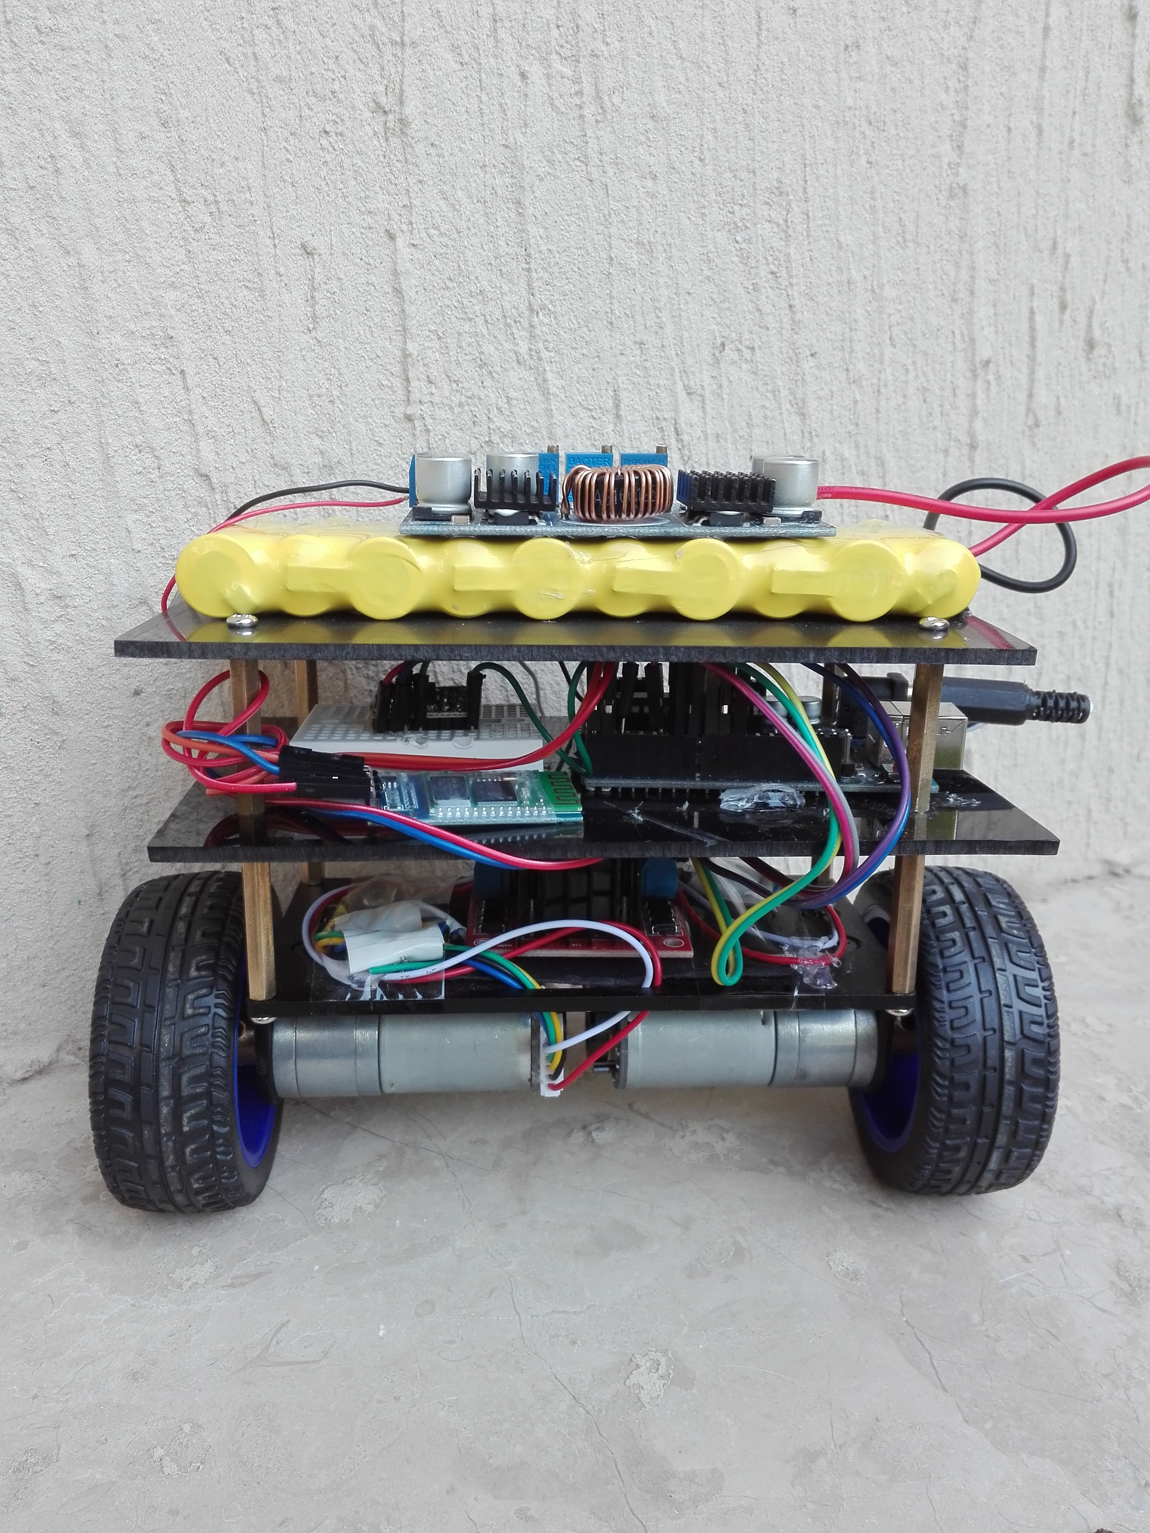
Self Balancing Robot
Group Members:
Muhammad Nouman Baqir Gardezi
Muhammad Zunair Sarwar Muhammad Waqas

Slide 2
In this Presentation we will discuss
What is a self balancing robot and its control mechanism. (M.Nouman)
Hardware and Software implementation using available resources.(M.waqas)
Self balancing robot applications and future insight.(M.Zunair)
Issues and Future work.(Baqir Gardezi).

Slide 3
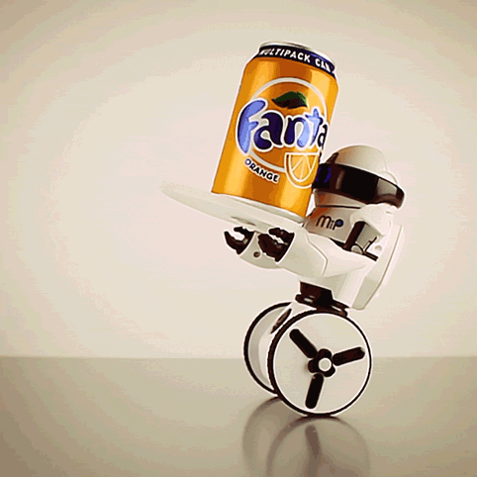
What Is Self Balancing Robot
A two wheel self-balancing robot is an important kind of mobile robots. Balancing robots means the capability of the robot to balance on its two wheels without falling.

Slide 4
How can a robot balance itself on two wheels?
The idea behind balancing a self balancing robot is the theory of inverted pendulum.
The inverted pendulum system, unlike many other control systems is naturally unstable.
Therefore, the system has to be controlled to reach stability in this unstable state.
A two-wheeled balancing robot is simply an inverted pendulum system which stands upright on two wheels.

Slide 5
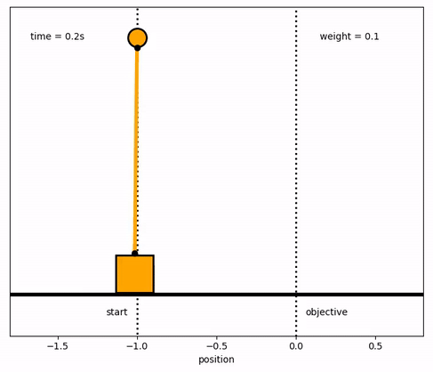
Inverted Pendulum and self balancing

Slide 6
Types of Controller for Self Balancing
Linear Quadratic Regulators (LQR).
Fuzzy Logic Control (FLC).
Neural Networks Control.
Sliding Mode Control (SMC).
Pole Placement Method.
Proportional Integral Derivative (PID).

Slide 7
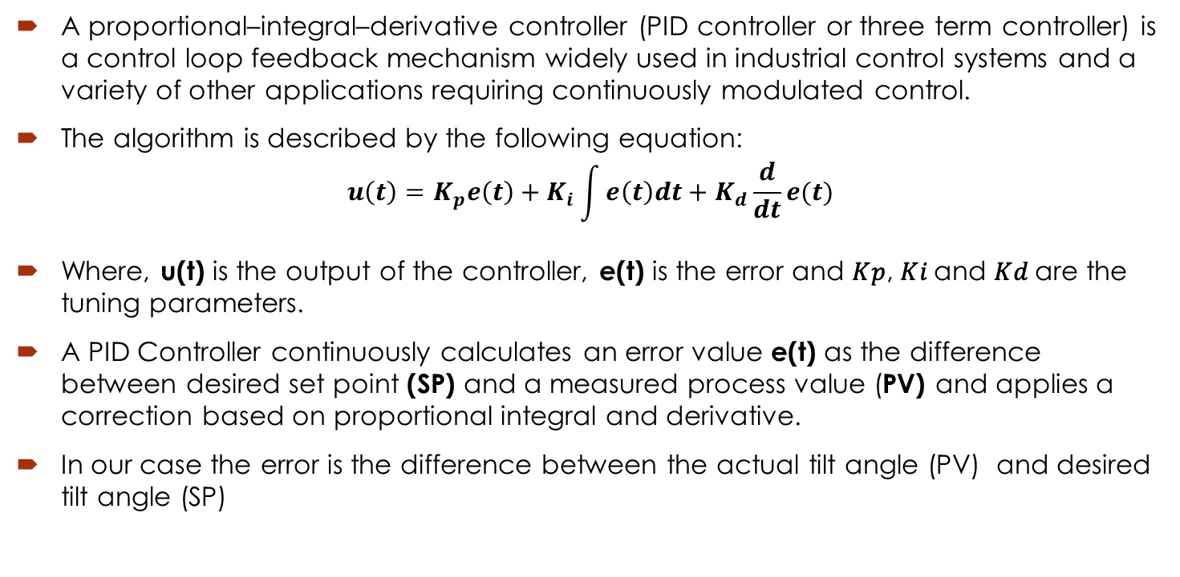
PID Controller Features
A proportional–integral–derivative controller (PID controller or three term controller) is a control loop feedback mechanism widely used in industrial control systems and a variety of other applications requiring continuously modulated control.
The algorithm is described by the following equation:
$$u\left(t\right)=K_{p}e\left(t\right)+K_{i}\int{e\left(t\right)dt}+K_{d}\frac{d}{dt}e(t)$$
Where, u(t) is the output of the controller, e(t) is the error and 𝐾𝑝, 𝐾𝑖 and 𝐾𝑑 are the tuning parameters.
A PID Controller continuously calculates an error value e(t) as the difference between desired set point (SP) and a measured process value (PV) and applies a correction based on proportional integral and derivative.
In our case the error is the difference between the actual tilt angle (PV) and desired tilt angle (SP)

Slide 8
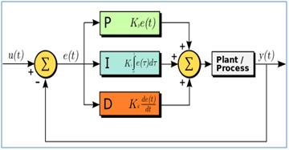
PID Closed FeedBack Mechanism

Slide 9
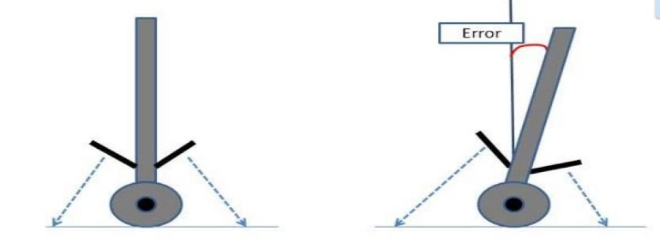
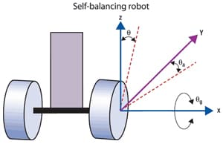
Tilt Angle Estimation
The tilt angle is calculated using the
Following formulae:
Error = Current Front Sensor Reading – Front Sensor Setpoint
Error = Back Sensor Setpoint – Current Back Sensor Reading
Output terms are generated as follow:
Output Proportional Term = Kp*Error
Output Integral Term = KpKi * Summation of Error * T
= KpKiT* (Summation of Error)
Output Differential Term = Kp*Kd*(Error – Previous Error)/T
=(Kp*Kd/T)*(Error – Previous Error)

Slide 10
Hardware and Software Implementation
Presented by M.Waqas

Slide 11
Hardware and Software Implementation
Hardware builds body while software is soul of it!
Hardware consists of:
Inertial Measurement Unit (IMU) commonly available as MPU 6050
Arduino UNO Board
Motor Driver Module L293D
DC high speed high torque Motors
Bluetooth Module HC-06 for communication
Mechanical frame
Power source

Slide 12











Block Diagram Of Robot Circuitry
DC Motor
Left
Motor
Driver
IMU
Arduino Board
sensor
Motor
Driver
DC Motor
Right

Slide 13
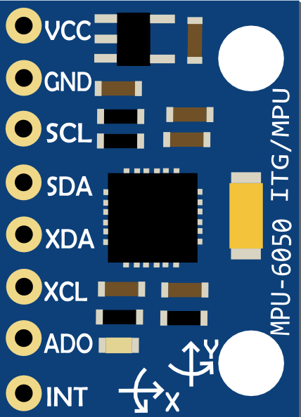
MPU 6050
Inertial Measurement Unit (IMU) MPU 6050 contains gyroscope and accelerometer both
Gyroscope senses tilt angle while accelerometer senses linear acceleration
This chip uses I2C (Inter Integrated Circuit) protocol for communication.
The module has on board Digital Motion Processor (DMP) capable of processing complex 9-axis Motion-Fusion algorithms.

Slide 14
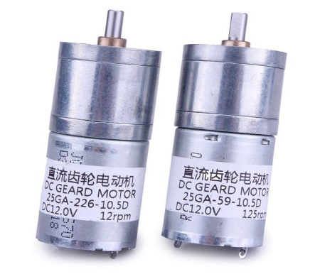
DC Geared Motors
The DC gear motor used as the actuator of the two wheel balancing robot
High torque motors are required to drag the whole system, so chosen motors have rated torque 0.127Nm
High speed assures quick response to tilt angle, so rated speed is 130rpm

Slide 15
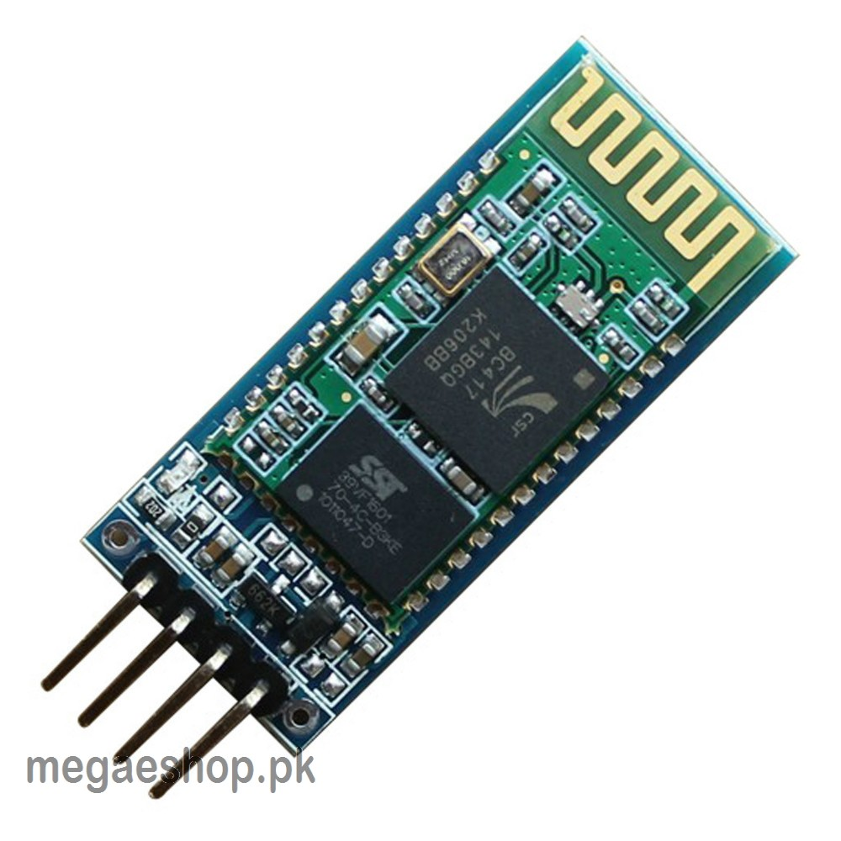
Bluetooth Module HC-06
The HC-06 is a class 2 slave Bluetooth module designed for transparent wireless serial communication. Once it is paired to a master Bluetooth device such as PC, smart phones and tablet.
The features are as follow:
Bluetooth v2.0+EDR
2.4GHz ISM band frequency
Default baud rate: 32400
Power supply: 3.6V to 6V DC
Pass key :1234

Slide 16
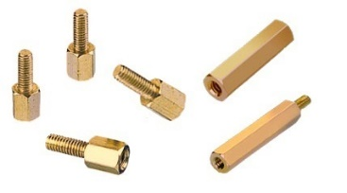
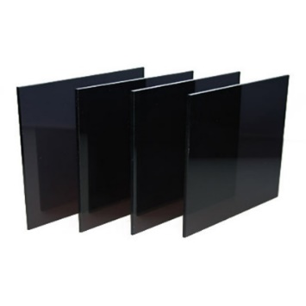
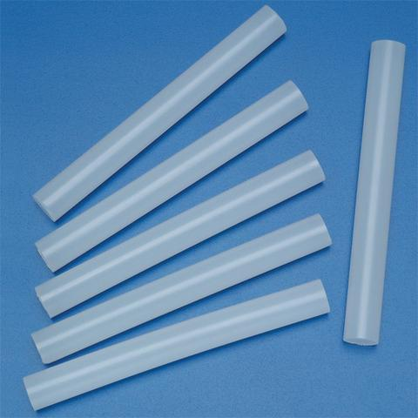
Mechanical Design
Mechanical structure of robot is build from the following material:
Arcylic Sheets
Brass male female spacer screws
Glue sticks
Card board

Slide 17
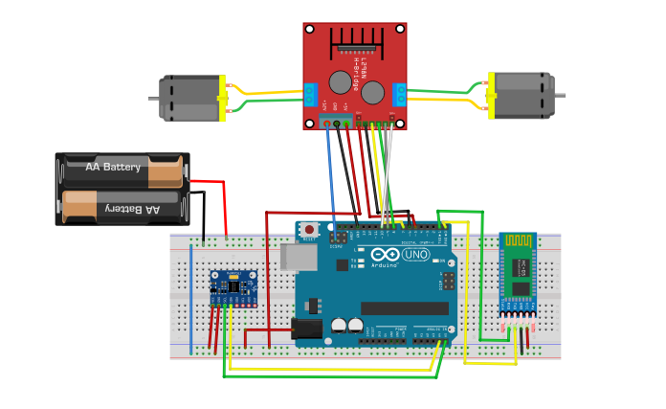
Circuit Schematics

Slide 18
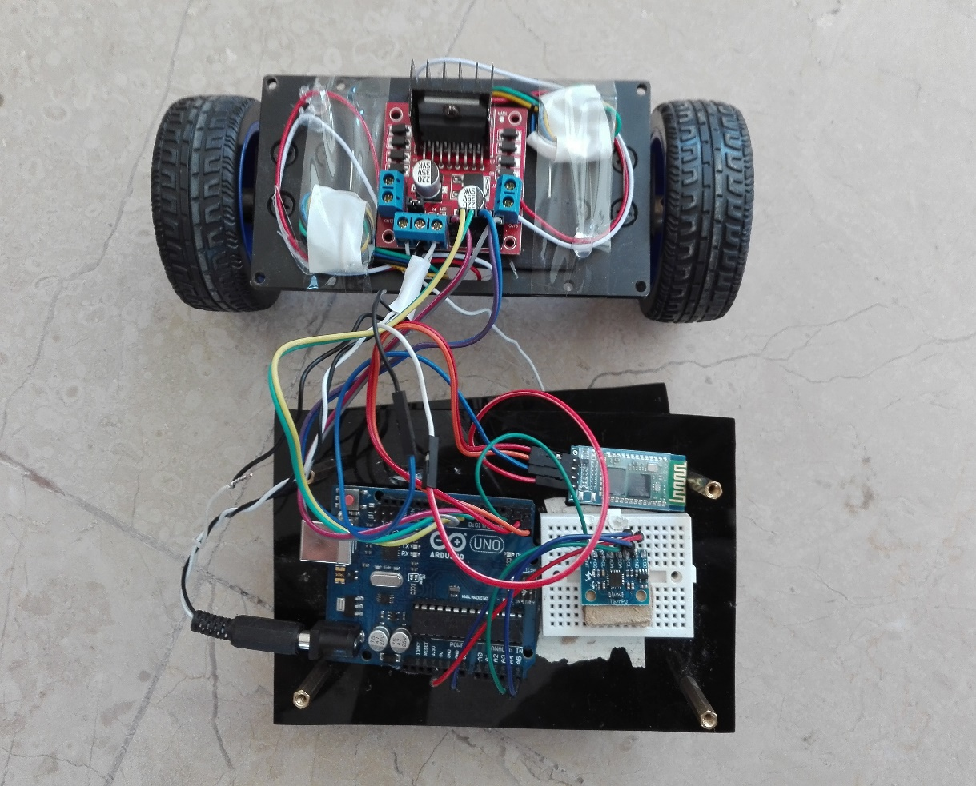
Robot Snaps

Slide 19
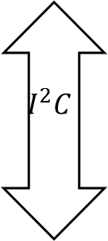
Code Algorithem Flow Diagram
MPU
(Raw data from DMP)
L-Motor Control Library
$$I^{2}C$$
Correction
L293D Driver
PID
Controller
Arduino
(Proper Angles in degree )

Slide 20
Tuning And Applications
Presented by M.Zunair Sarwar

Slide 21
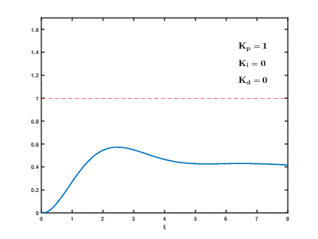
Tuning Of PID

Slide 22
Applications and future Insight
This type of robot has gained fame and interest among researchers and engineers because it utilizes such a control system that is used to stabilize an unstable system using efficient microcontrollers and sensors.
Two-wheeled balancing robots can be used in several applications with different perspectives such as an intelligent gardener in agricultural fields, an autonomous trolley in hospitals, shopping malls, offices, airports, healthcare applications or an intelligent robot to guide blind or disable people.
These types of robots can effectively work in non-uniform surfaces due to their balanced control system.
All of its application are due to the fact that it is dynamically stable.

Slide 23
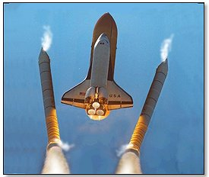
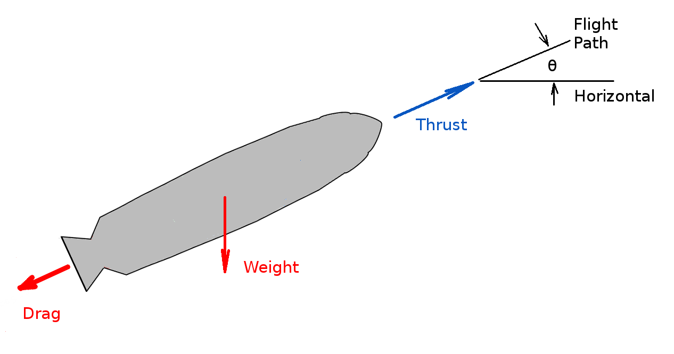
Application In Rocket Propulsion

Slide 24
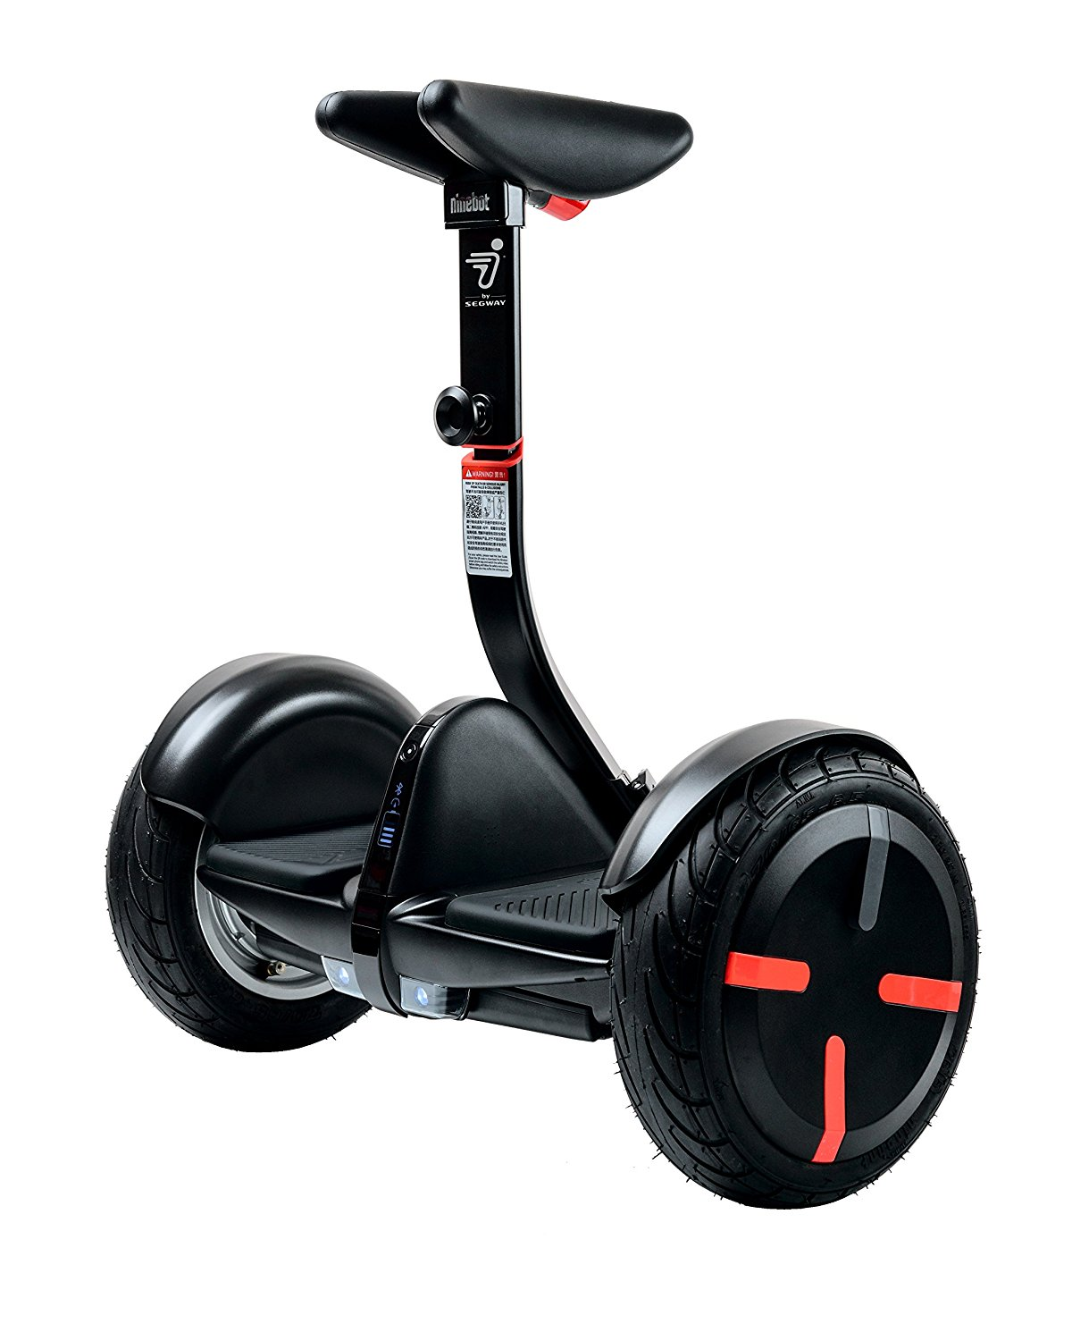
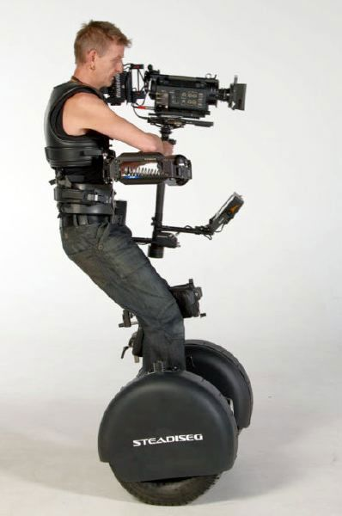
Segway

Slide 25
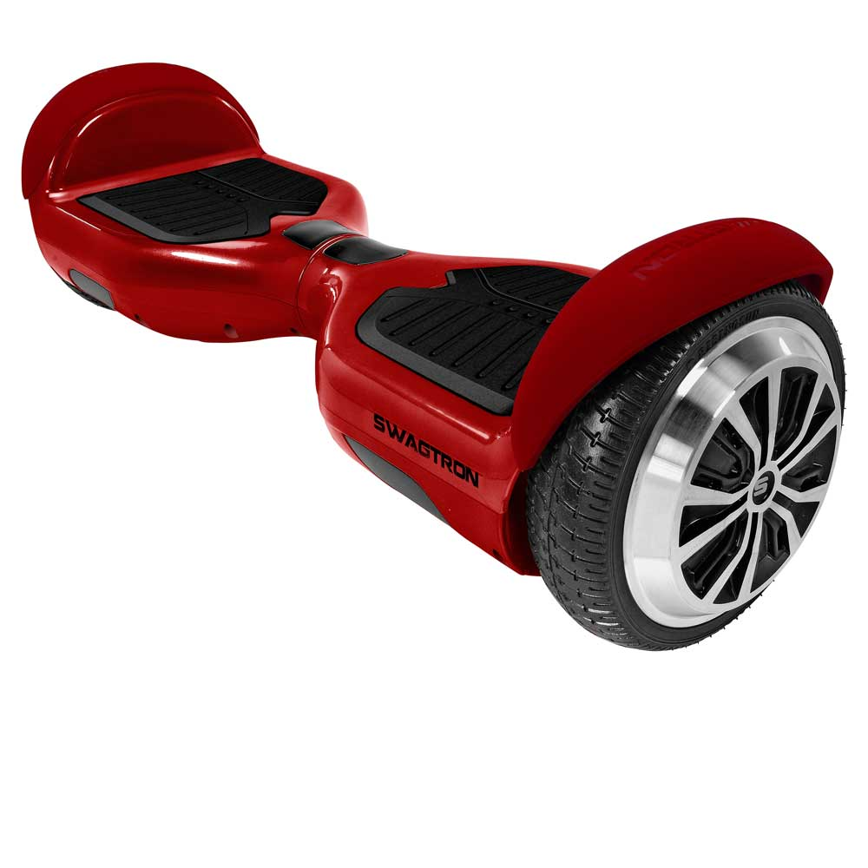
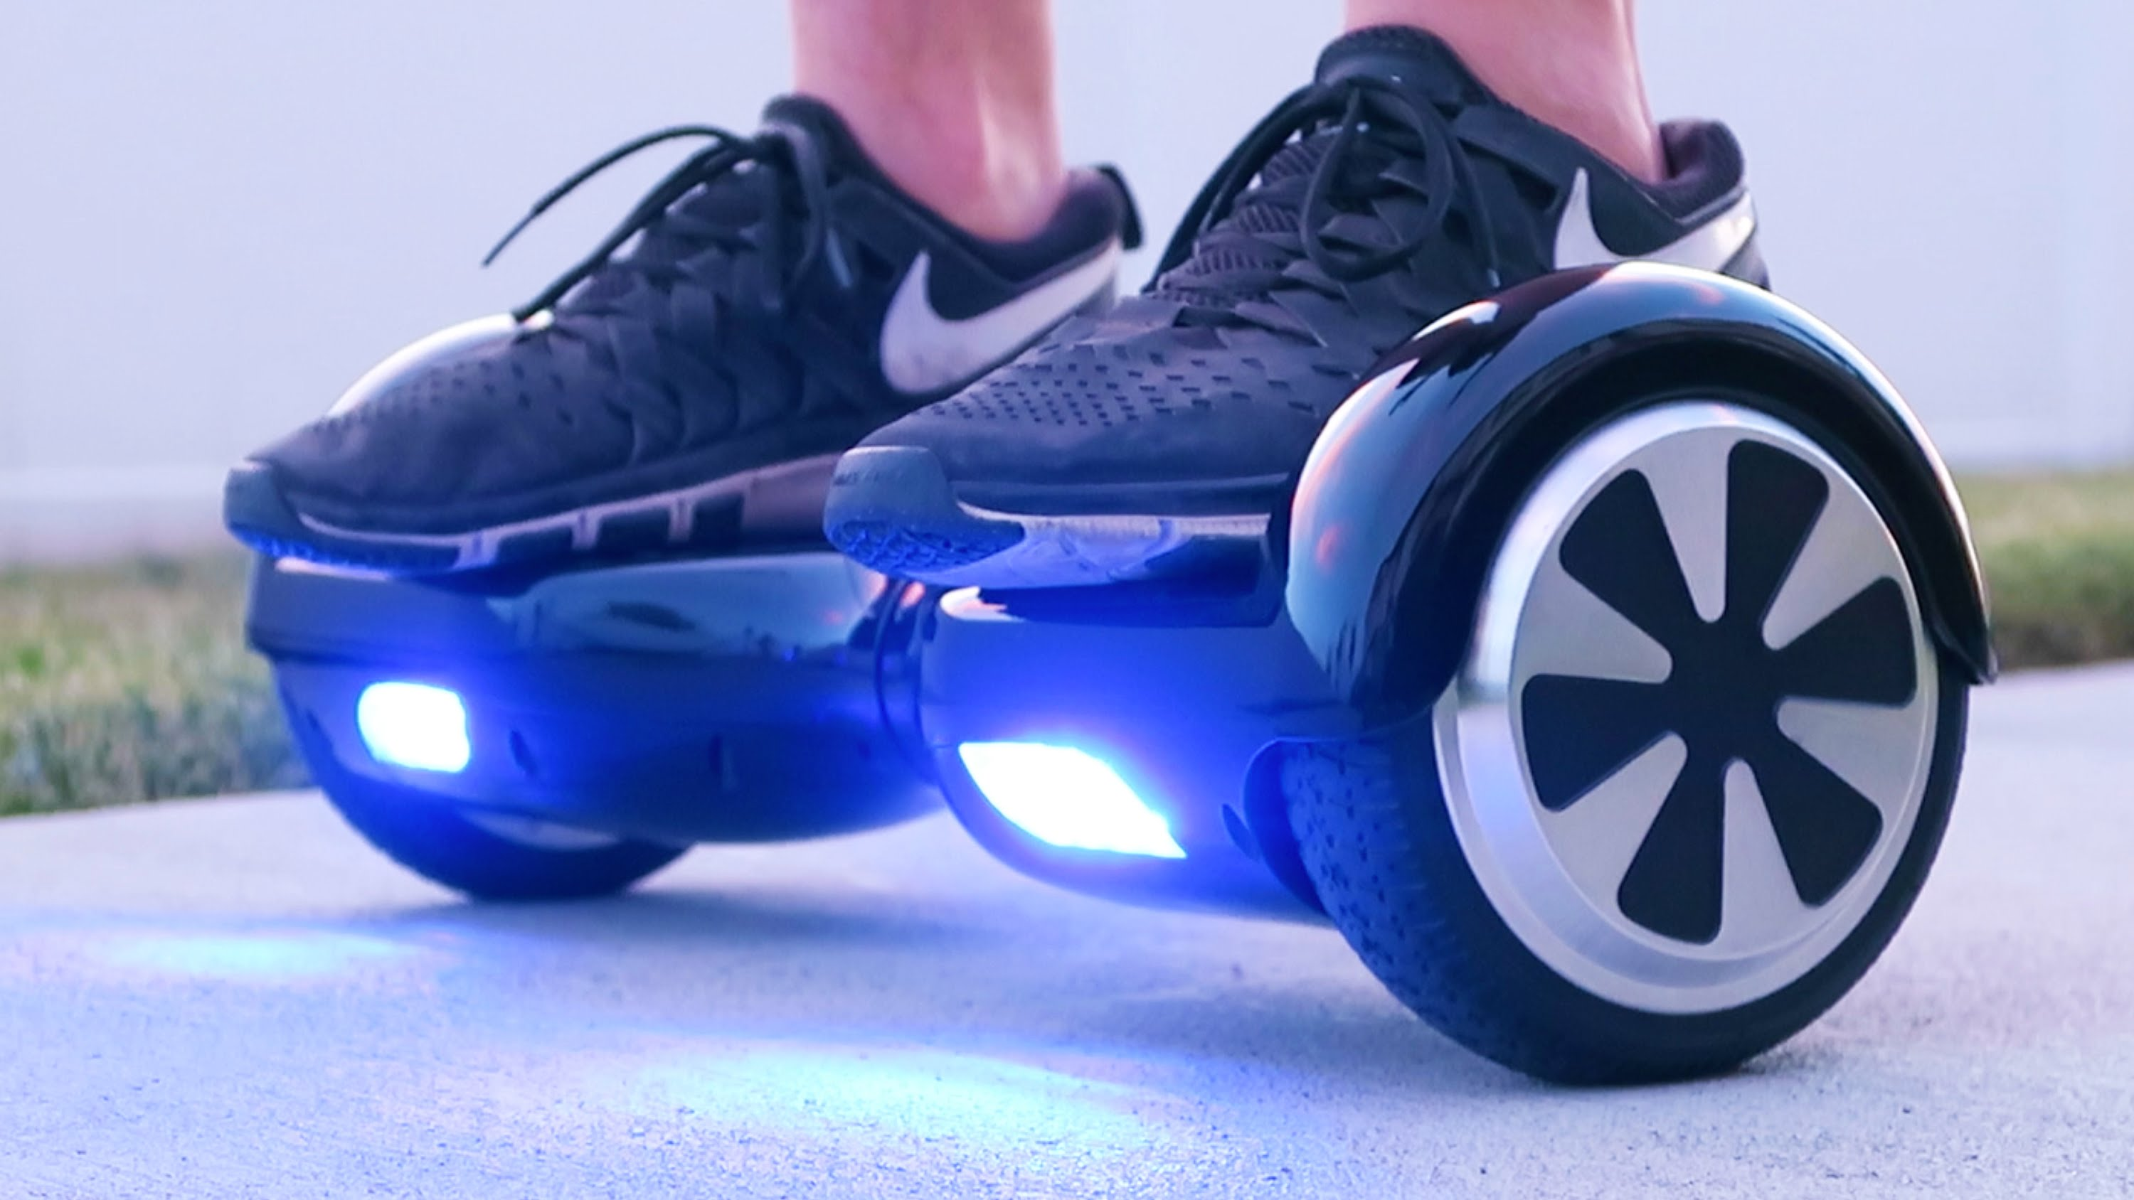
Hoverboard

Slide 26
Issues and Future Work Suggestions
Presented By Baqir Gardezi

Slide 27
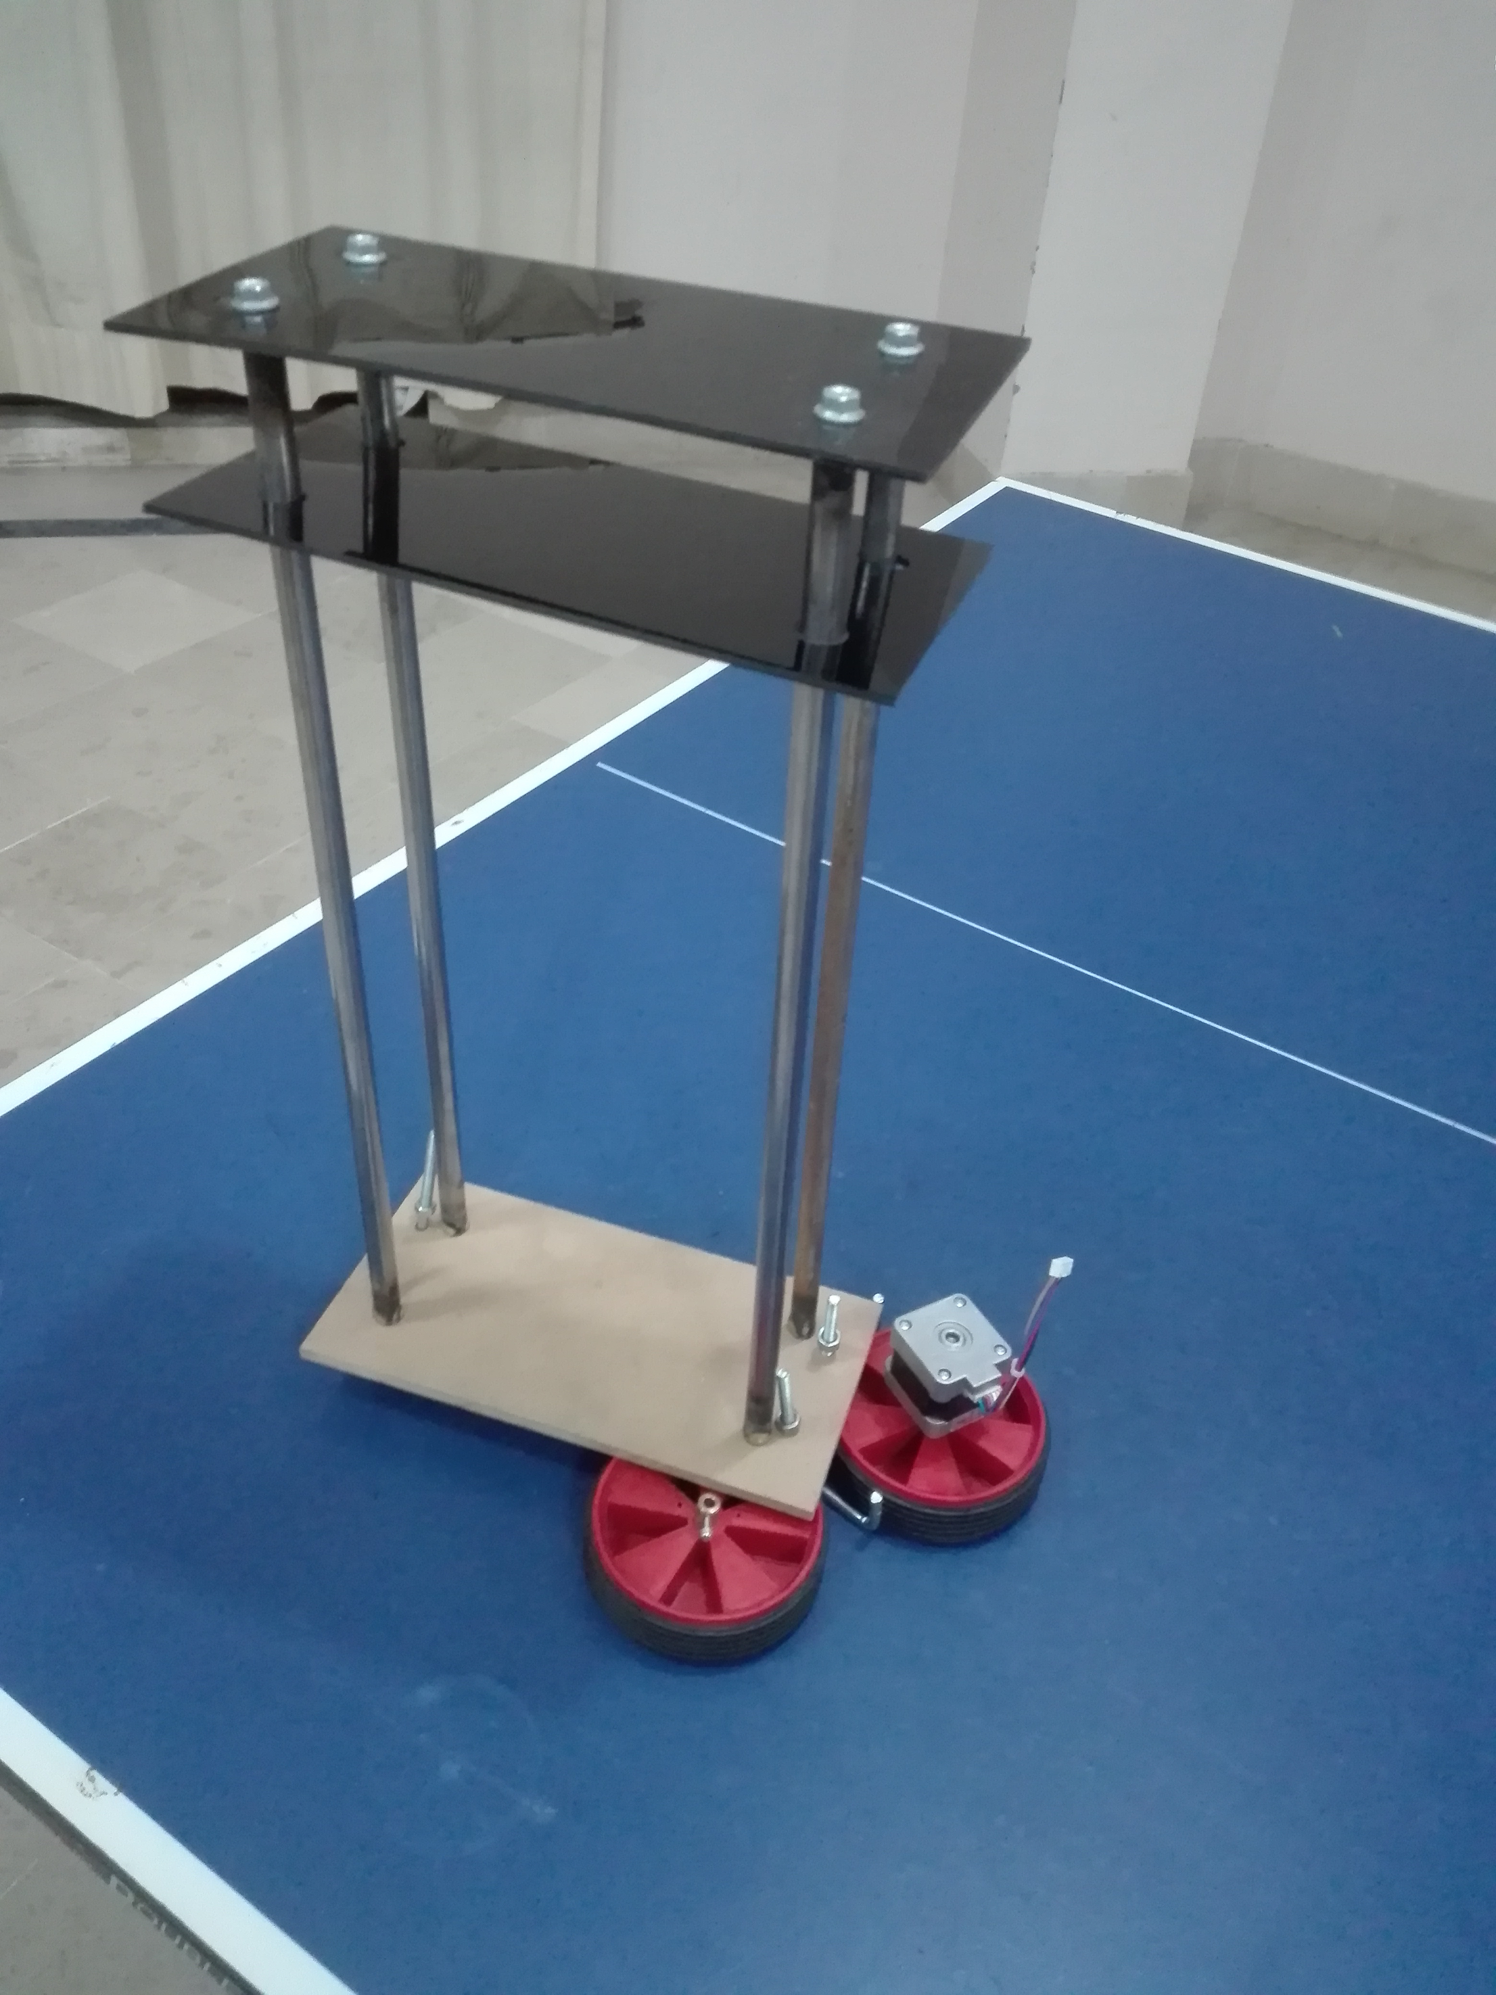
Problems
Following issues were faced during the
Work of project.
Mechanical Design
Motors Power
Battery isuues
PID Tuning
Unbalanced surface for Gyro
Motor Speed Control
Sensor noise

Slide 28
Future Work Suggestions
Must build the mathematical model of robot for tuning of PID .
Motors must be of same speed.
Try to make the upper surface of robot exactly flat.
Robot’s Center of mass must exactly pass through the axis vertically.
Unequal weight distribution will unbalance the robot.
Using Filtering technique to read gyro will enhance the working of robot.
Using Raspberry pi and different control mechanism will greatly increase the performance of robot.

Slide 29

Question and Answer Session

